Slide 1
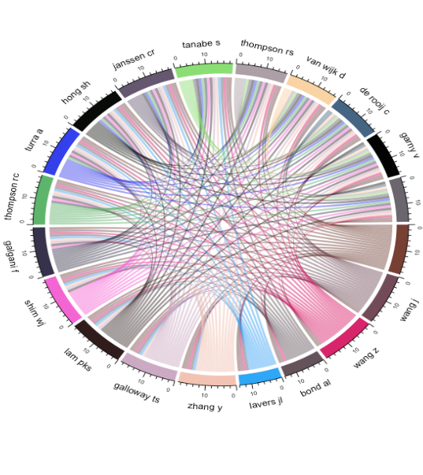
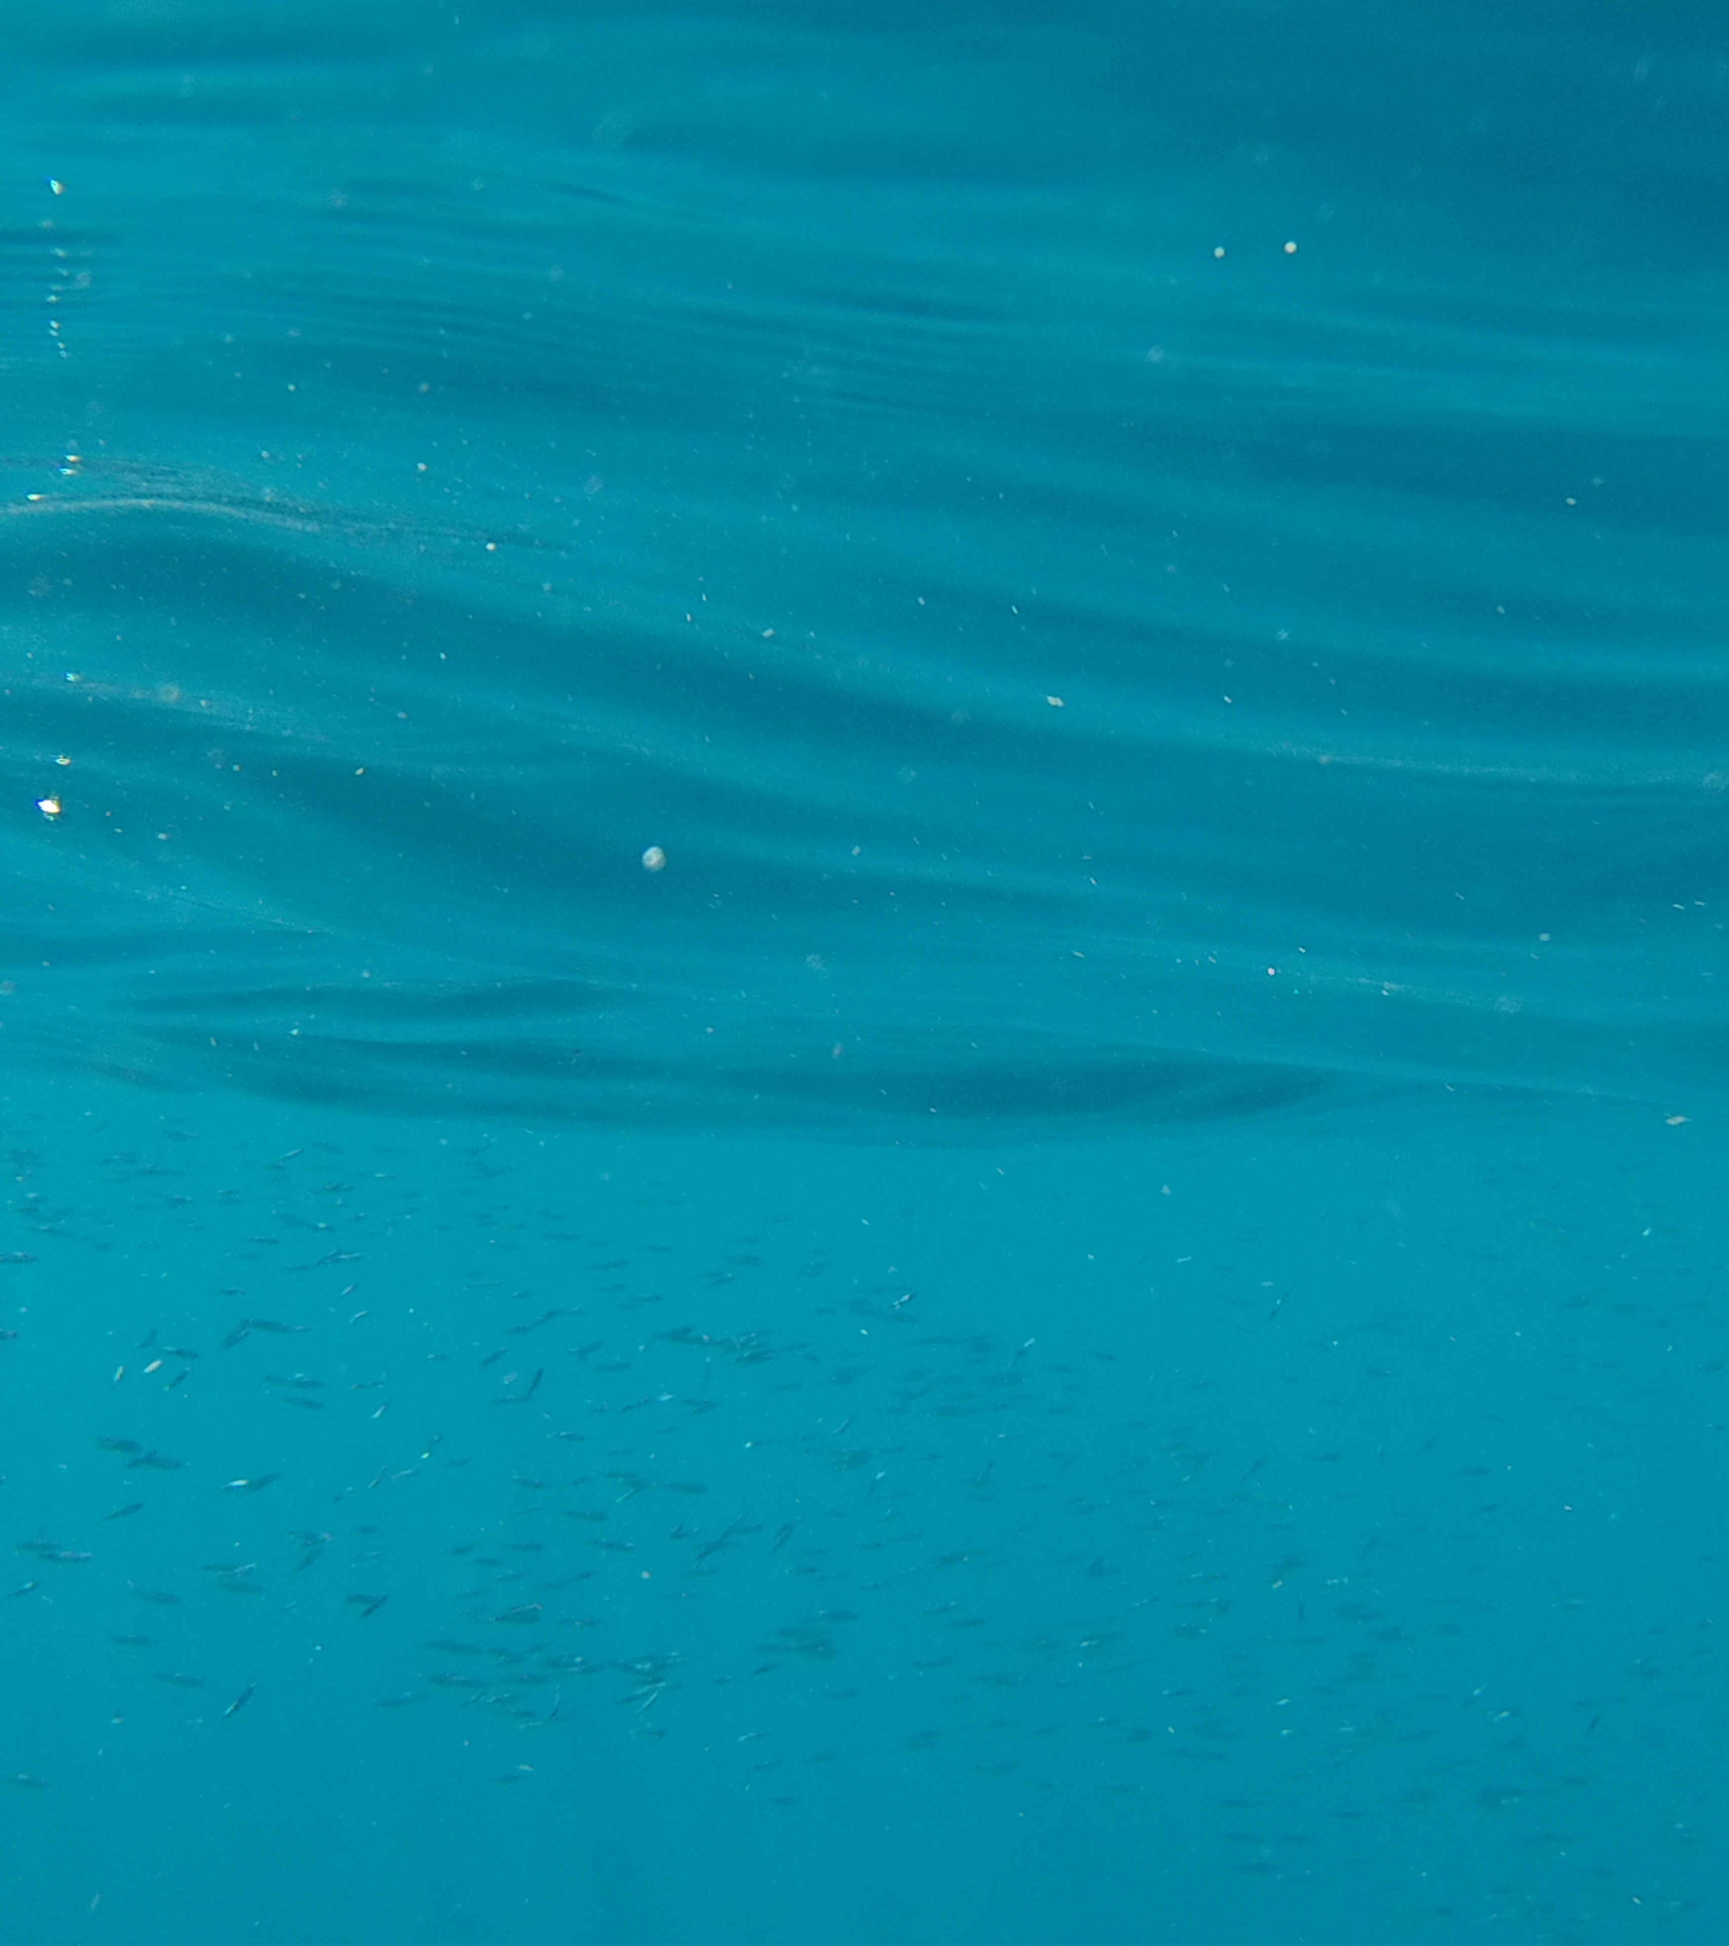
Marine Pollution: Global issue, clustered research? Brie Sherow

Slide 2
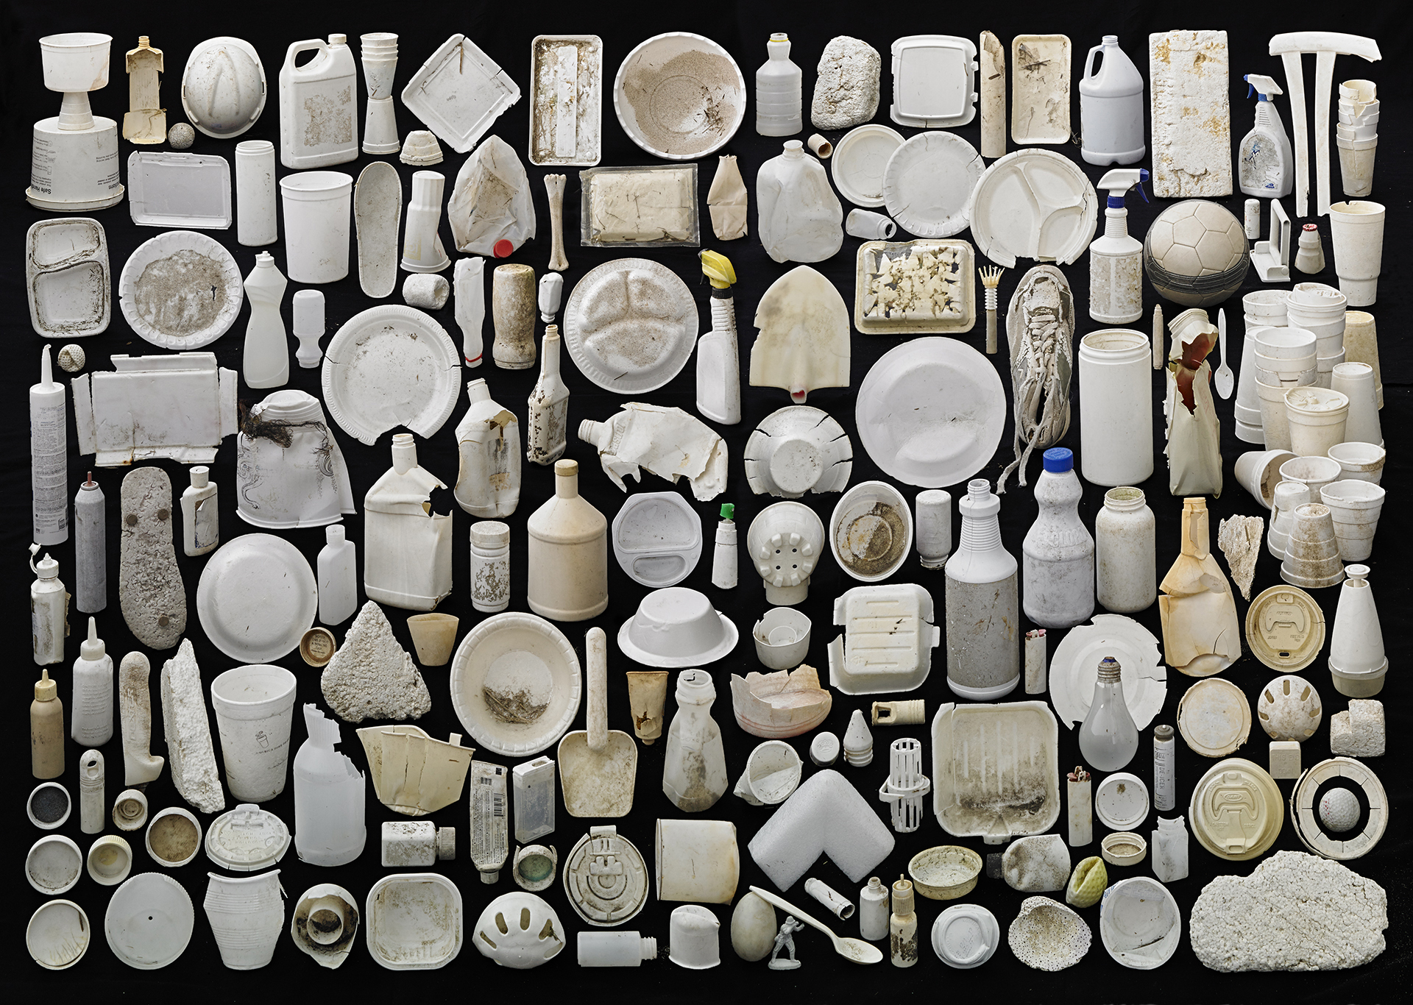
Marine pollution is a global issue
Knowledge gaps make it difficult to address the issue.
-- Bonanno and Orlando-Bonaca 2018
Environmental
Economic
Public Health
Social
Impacts are not fully understood as research is not standardized.
-- Galgani 2015
Artwork by Barry Rosenthal
Notes:
BACKGROUND: Background - Is there sufficient background provided for someone not familiar with the field to understand what the talk is about?
Marine pollution is a global issue that has widespread effects on ecological, economic, and social systems.
The first widely accepted definition of marine pollution came from the UN in 1982. The ‘introduction by man, directly or indirectly, of substances or energy into the marine environment, including estuaries, which results or is likely to result in such deleterious effects as harm to living resources and marine life, hazards to human health, hindrance to marine activities, including fishing and other legitimate uses of the sea, impairment of quality for use of sea water and reduction of amenities’ (United Nations 1982).
The negative impact of marine pollution is widely accepted by scientists, policy makers, and the general public although knowledge gaps make it difficult to address the issues. Furthermore, the lack of standardisation in the research makes it difficult to understand the full impacts.

Slide 3
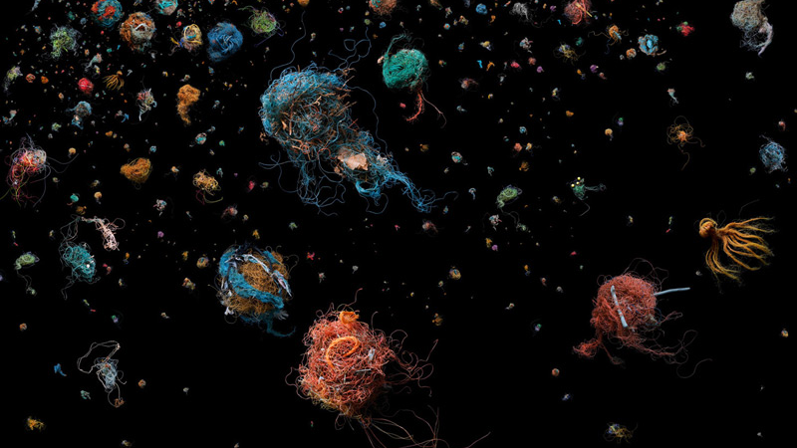
Questions
Hypothesis
Are there gaps in the geography of marine pollution research?
Clustered research dominated by key players
Has the topical focus changed over time?
Topics change from industrial pollutants to plastic specific
Artwork by Mandy Barker
Notes:
AIM / QUESTIONS / HYPOTHESIS- Were the aims of the study or hypotheses to be tested explicitly stated?
This paper aims to map the clusters in geographies and topics in published marine pollution research in order to determine where there are still gaps. I predict that, although all clusters of research have grown, the proportions have changed over time moving from a variety of industrial pollution types to debris and plastics more specifically. Marine pollution does not respect national boundaries, yet research clusters do, and may not represent the regions most impacted by marine pollution. Thus, I will record how our research of marine pollution and its impacts have changed over time, and who is driving this research.

Slide 4
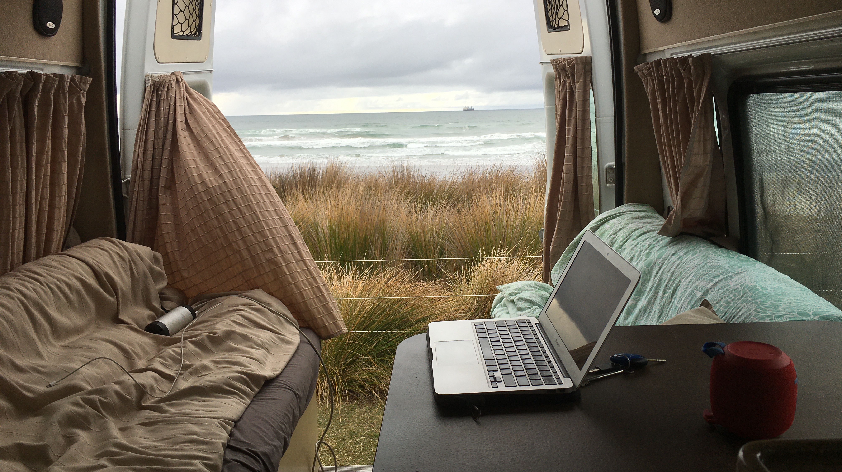
Methods
SCOPUS search
EXACTKEYWORD ( "marine pollut*" ) AND ( LIMIT-TO ( SUBJAREA , "ENVI" ) ) AND ( LIMIT-TO ( DOCTYPE , "ar" ) OR LIMIT-TO ( DOCTYPE , "cp" ) OR LIMIT-TO ( DOCTYPE , "re" ) ) AND ( LIMIT-TO ( LANGUAGE , "English" ) )
bibliometrix package in R
-- Aria and Cuccurullo 2017
-- R Core Team 2020
Notes:
METHODS - Are the methods described in adequate detail for an oral presentation?
This instructs Scopus to search for records tagged with the keyword ‘Marine Pollution’ and limited to the subject area of ‘Environmental Science’. A filtering process was used to include only publications in English and to limit document types to articles, conference papers, and reviews. Excluded 2020 as it’s still in progress. This search resulted in a total of 9728 bibliometric records available for further analysis. I then used bibliometrix package in R to transform a Scopus BibTeX file into a dataframe used for analysis. I will describe the methods for each graphic alongside the results.

Slide 5
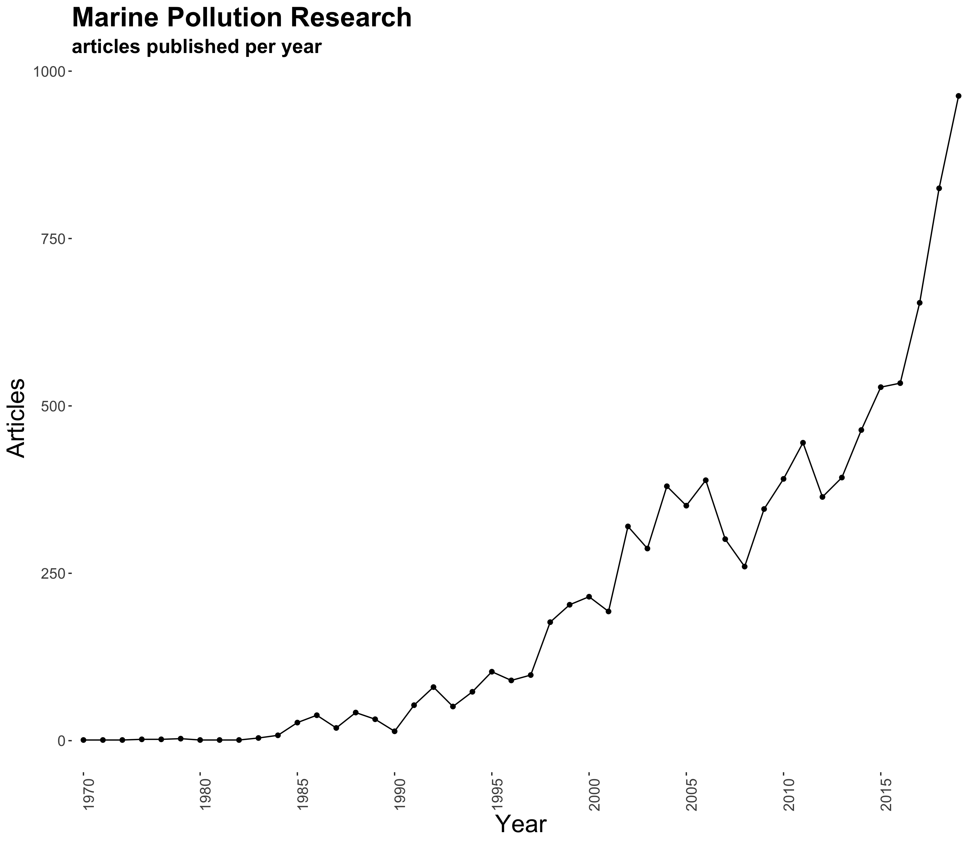
Marine Pollution Research
total publications per year
Jambeck et al 2015, Plastic Waste Inputs from Land into the Ocean
Cole et al 2011, Microplastics as Contaminants in the Marine Env.
Wright et al 2014, The Physical Impacts of Plastics on Marine Organisms
Andrady 2011, Microplastics in the Marine Environment
Derraik 2002, Pollution of the Marine Environment by Plastic Debris
Influential Papers
(more than 100 citations)
Hidalgo-Ruz et al 2012, Microplastics in the Marine Environment: A review of the methods used for id. and quantification
Notes:
RESULTS – Were the results presented clearly and in a logical sequence?
Of these influential papers, all are about plastics. Four are reviews.

Slide 6
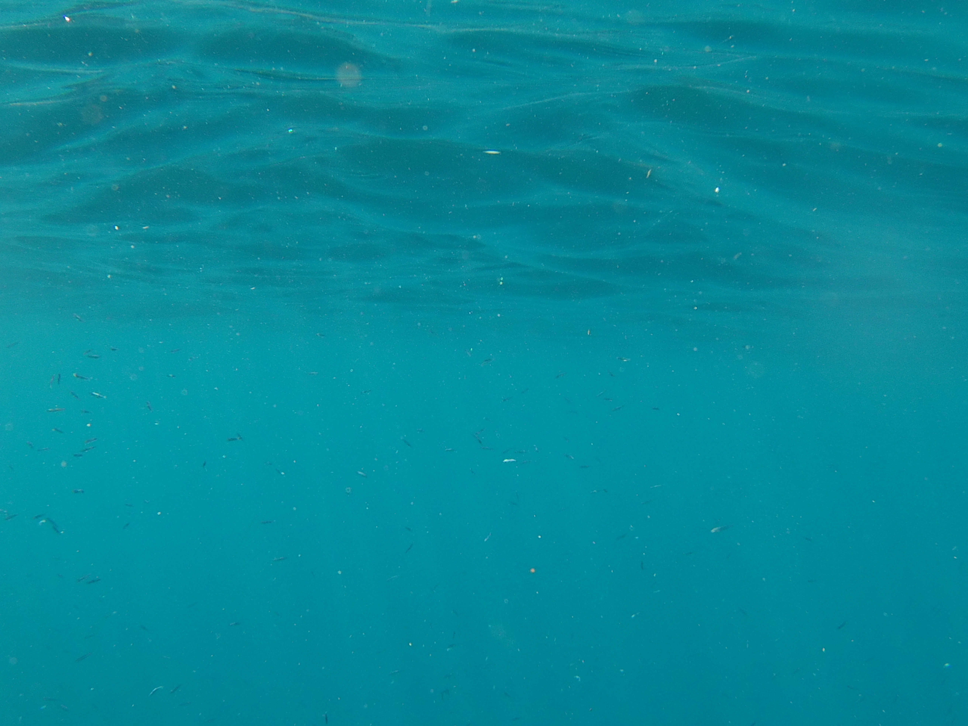
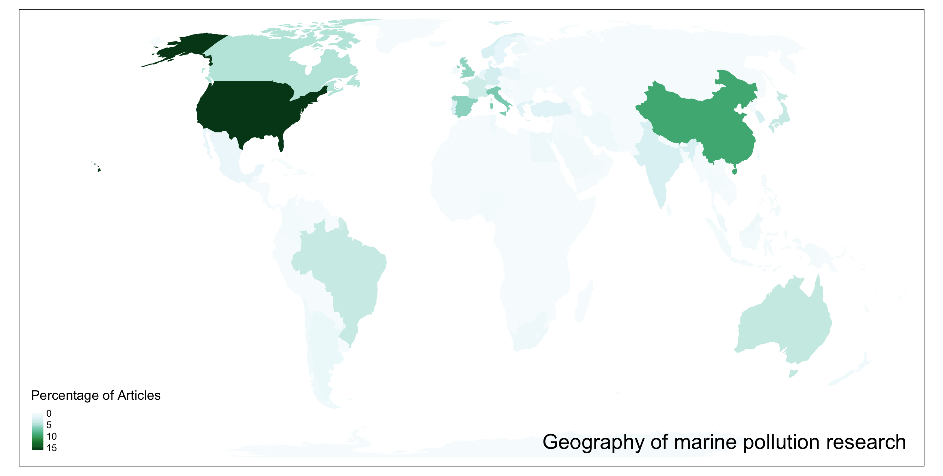
tmap package in R. M. Tennekes. 2018.
Notes:
RESULTS – Were the results presented clearly and in a logical sequence?
Surprises – besides US and China, most countries sitting around 5% or less, with 102 countries represented. Research is spread across the globe. There are 102 countries whose research institutions have published about marine pollution so the research is quite widespread, of those, more than 50% are made up of the top 7 so it is quite clustered.

Slide 7
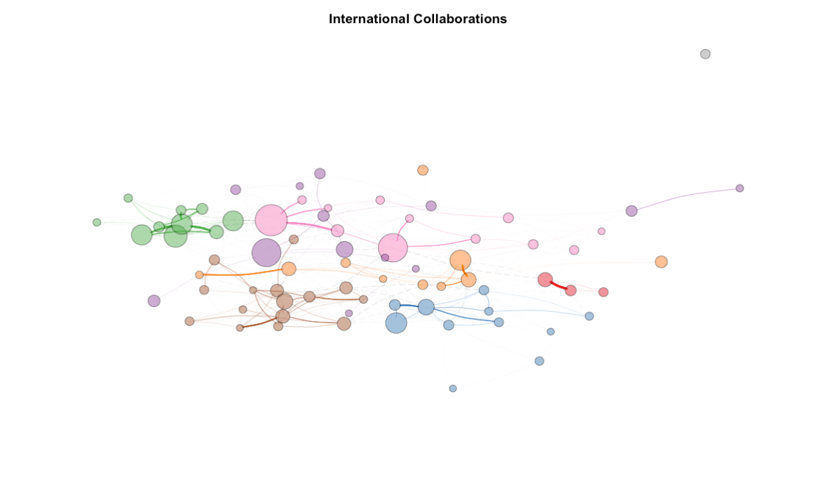
Unreported Affiliation
Intra and International Collaborations
China
Asia
USA
UK
Portugal
Canada & Arctic
Europe
Igraph package in R, Sardi, G., and T. Nepusz. 2006.
Notes:
RESULTS – Were the results presented clearly and in a logical sequence?
This is using Fruchterman-Reingold layout. China is tightly clustered intra-nationally, as is Portugal with fewer institutions. Northern Europe is very collaborative internationally, Canadian universities have more ties with Scandinavia than they do with neighbouring USA. UK is loosely tied with continental Europe, but still in its own group. Interesting that Brazil is grouped with USA, but very loosely. Japan works more with Hong Kong, Korea, and India. Interesting to note that Canadian Universities are working with Arctic specific institutions in Northern Europe. Hong Kong, Ehime University in Japan, as well as India and Korea. Australia Universites are grouped in the USA group, the UK group, and the Canadian group - are they not working with each other?

Slide 8
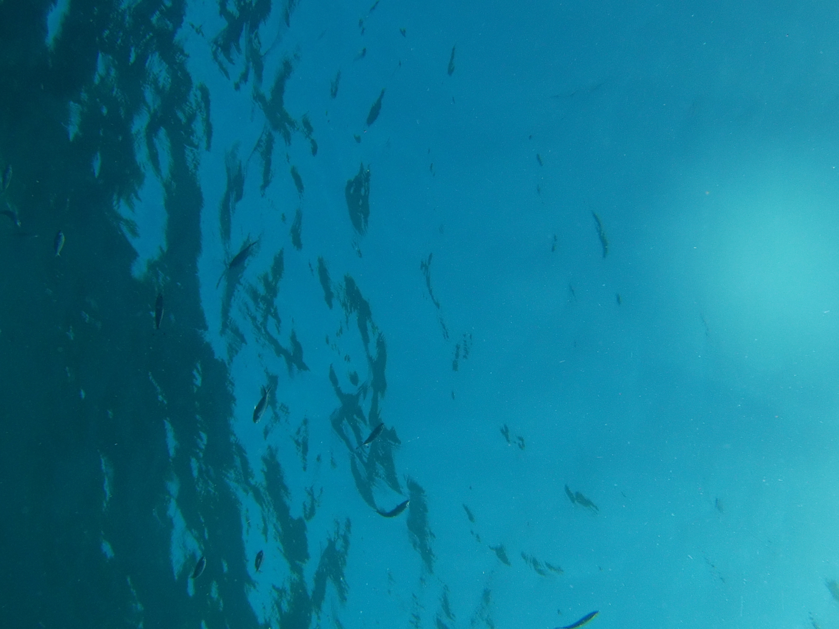
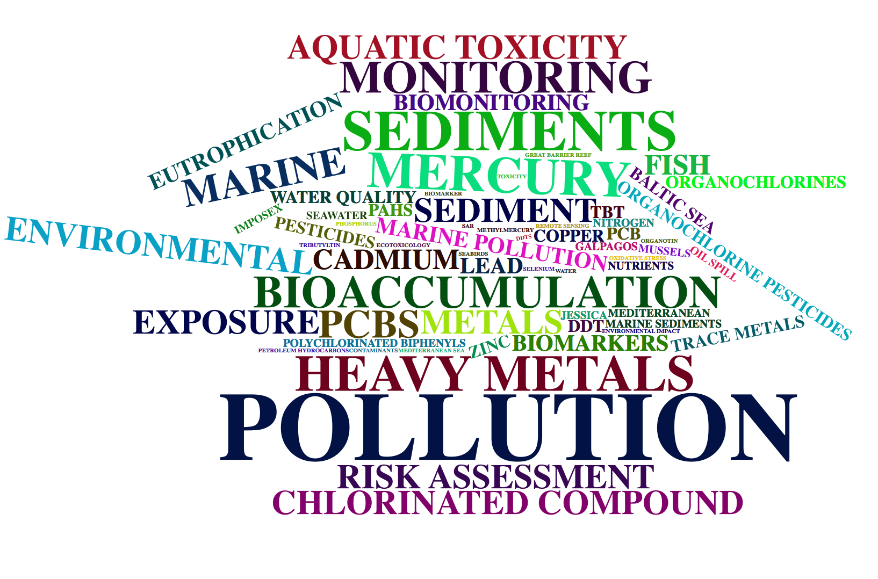
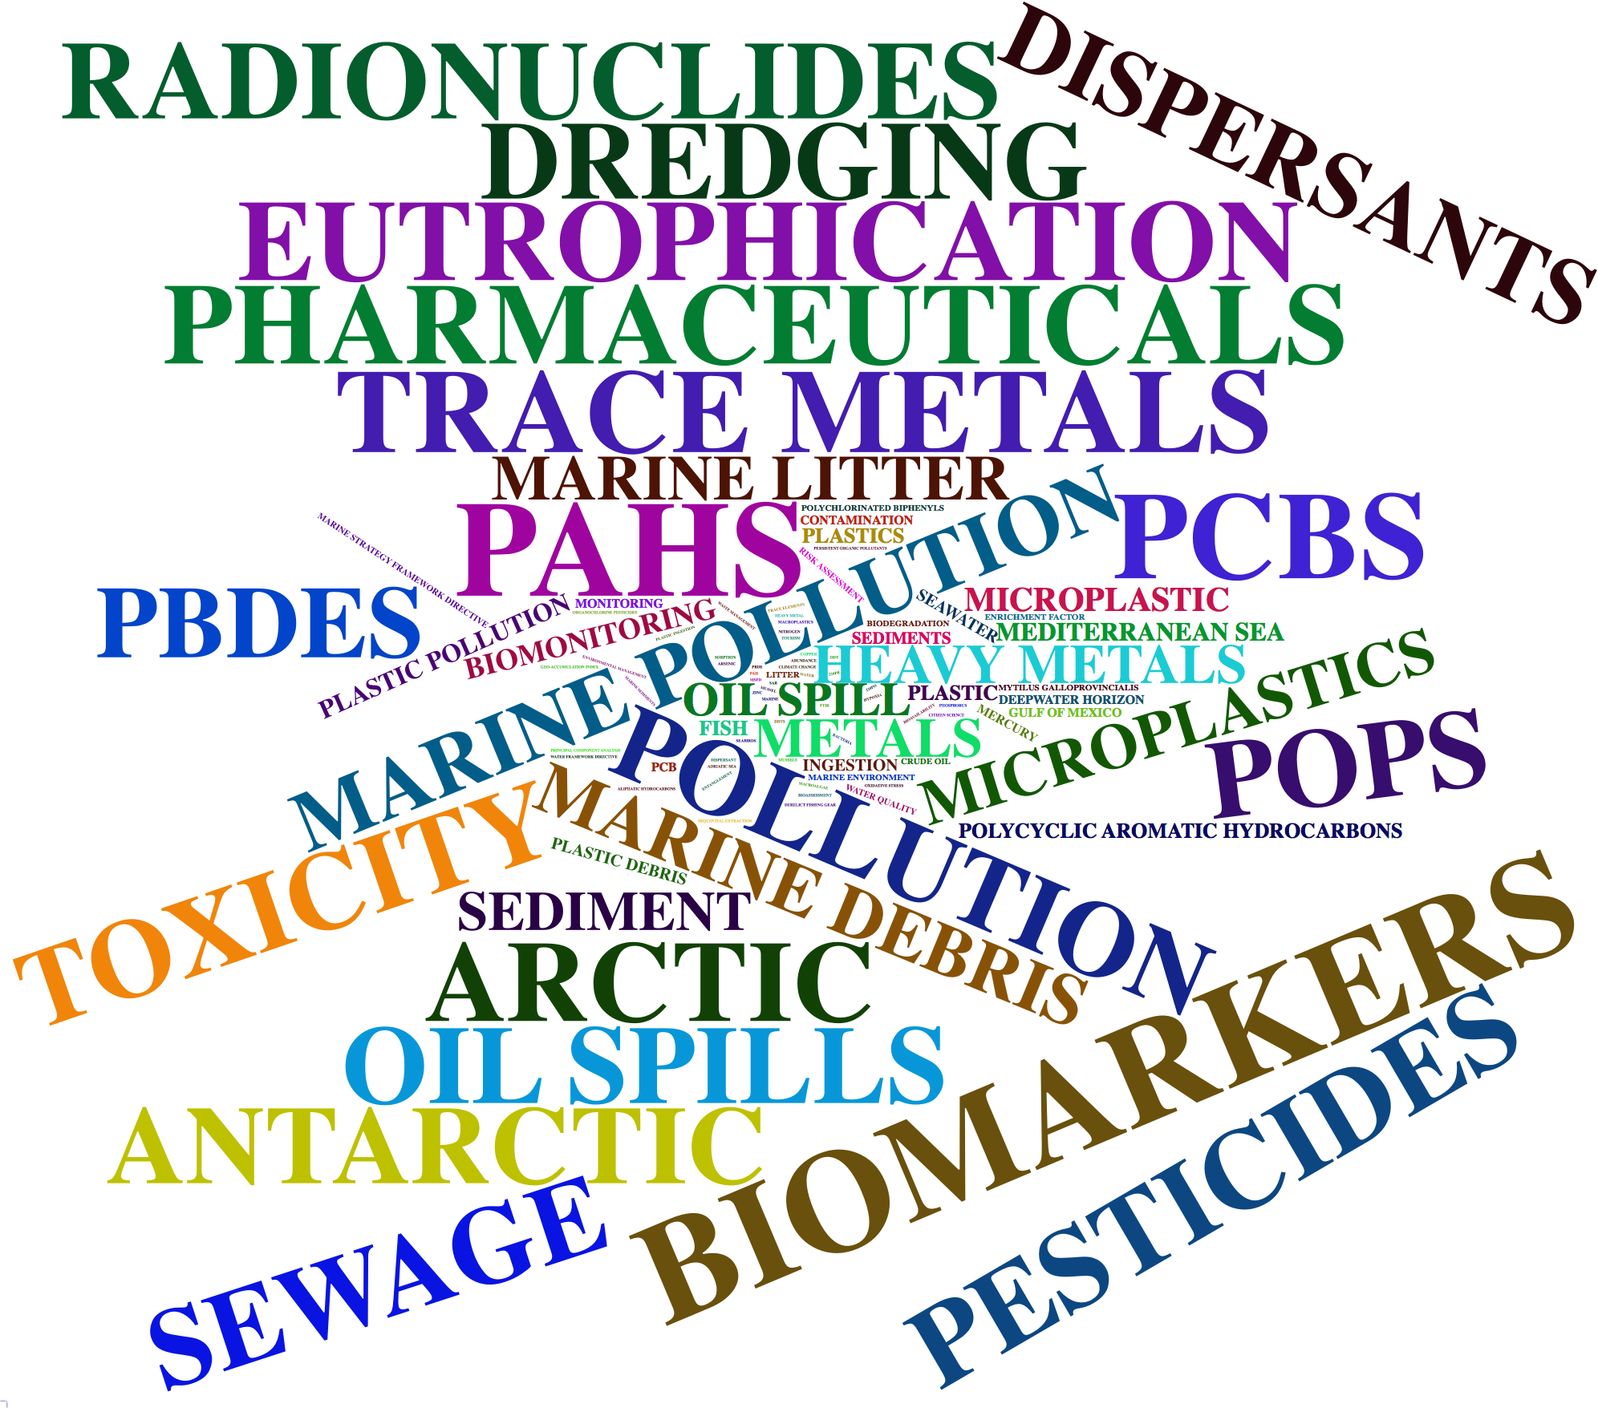
Author Keywords
2010-2019
1970-2009
Wordcloud2 package in R. Lang, D., and G. Chien. 2018
Notes:
RESULTS Were the results presented clearly and in a logical sequence?
Wordclouds are great for visualization, and here we can get some clues about where we might follow up in a more rigorous analysis. Early research you can see heavy metals, based on risk, bioaccumularion and eutrophication, so we might look into agricultural and industrial pollution. There isn’t much focus on plastics, bar mention of PCBs and chlorinated compounds. Recent research still shows metals, pesticides, oil spills and eutrophication, but now we see many more plastics related words and focus on debris and litter. It’s hard to see with the size, but we’ve also got mention of climate change and PAH from emissions. Also interesting to see pharmaceuticals there.

Slide 9
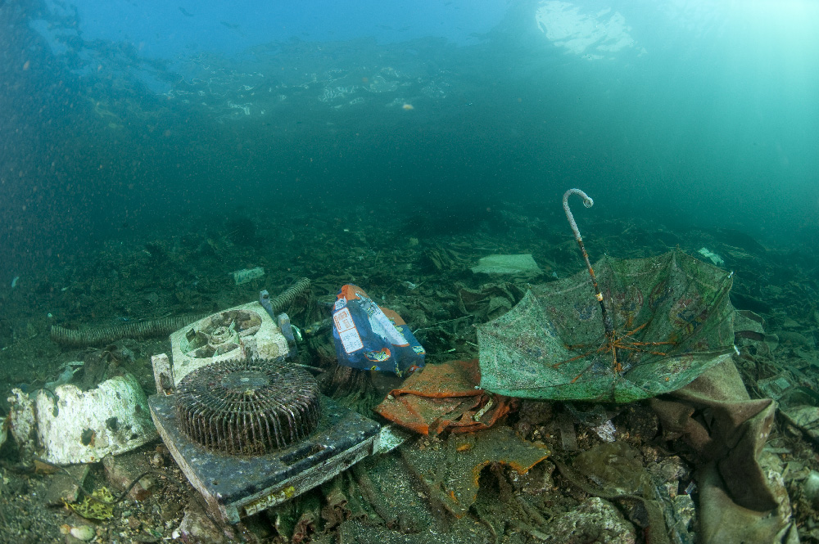
Discussion and
Suggestions for Further Analysis
Quantify changes in keywords, map topics to research cluster
Location of research sites compared to institutions
Explore one topic area to assess patterns in research and policy
Notes:
DISCUSSION Were the key findings and conclusions of the study clearly stated and supported by data?
It’s clear that marine pollution research is growing and topic areas are changing, however further analysis is needed to answer the initial research questions
Wordclouds are effective for visualising data, but in order to understand the evolution of the research we need to quantify the changes in keywords over time. Further study could analyse keywords by research cluster to determine the gaps in research.
We have record of where the research institution is based, but this is not necessarily indicative of where the research is taking place.
Not within the scope of this project, but I would love to look more in depth at the relationship between research and policy. Take one topic area (heavy metals, POP, debris/litter, pharmaceuticals) to determine patterns in research compared to global policy changes, perhaps by looking at influential authors and their affiliations.

Slide 10
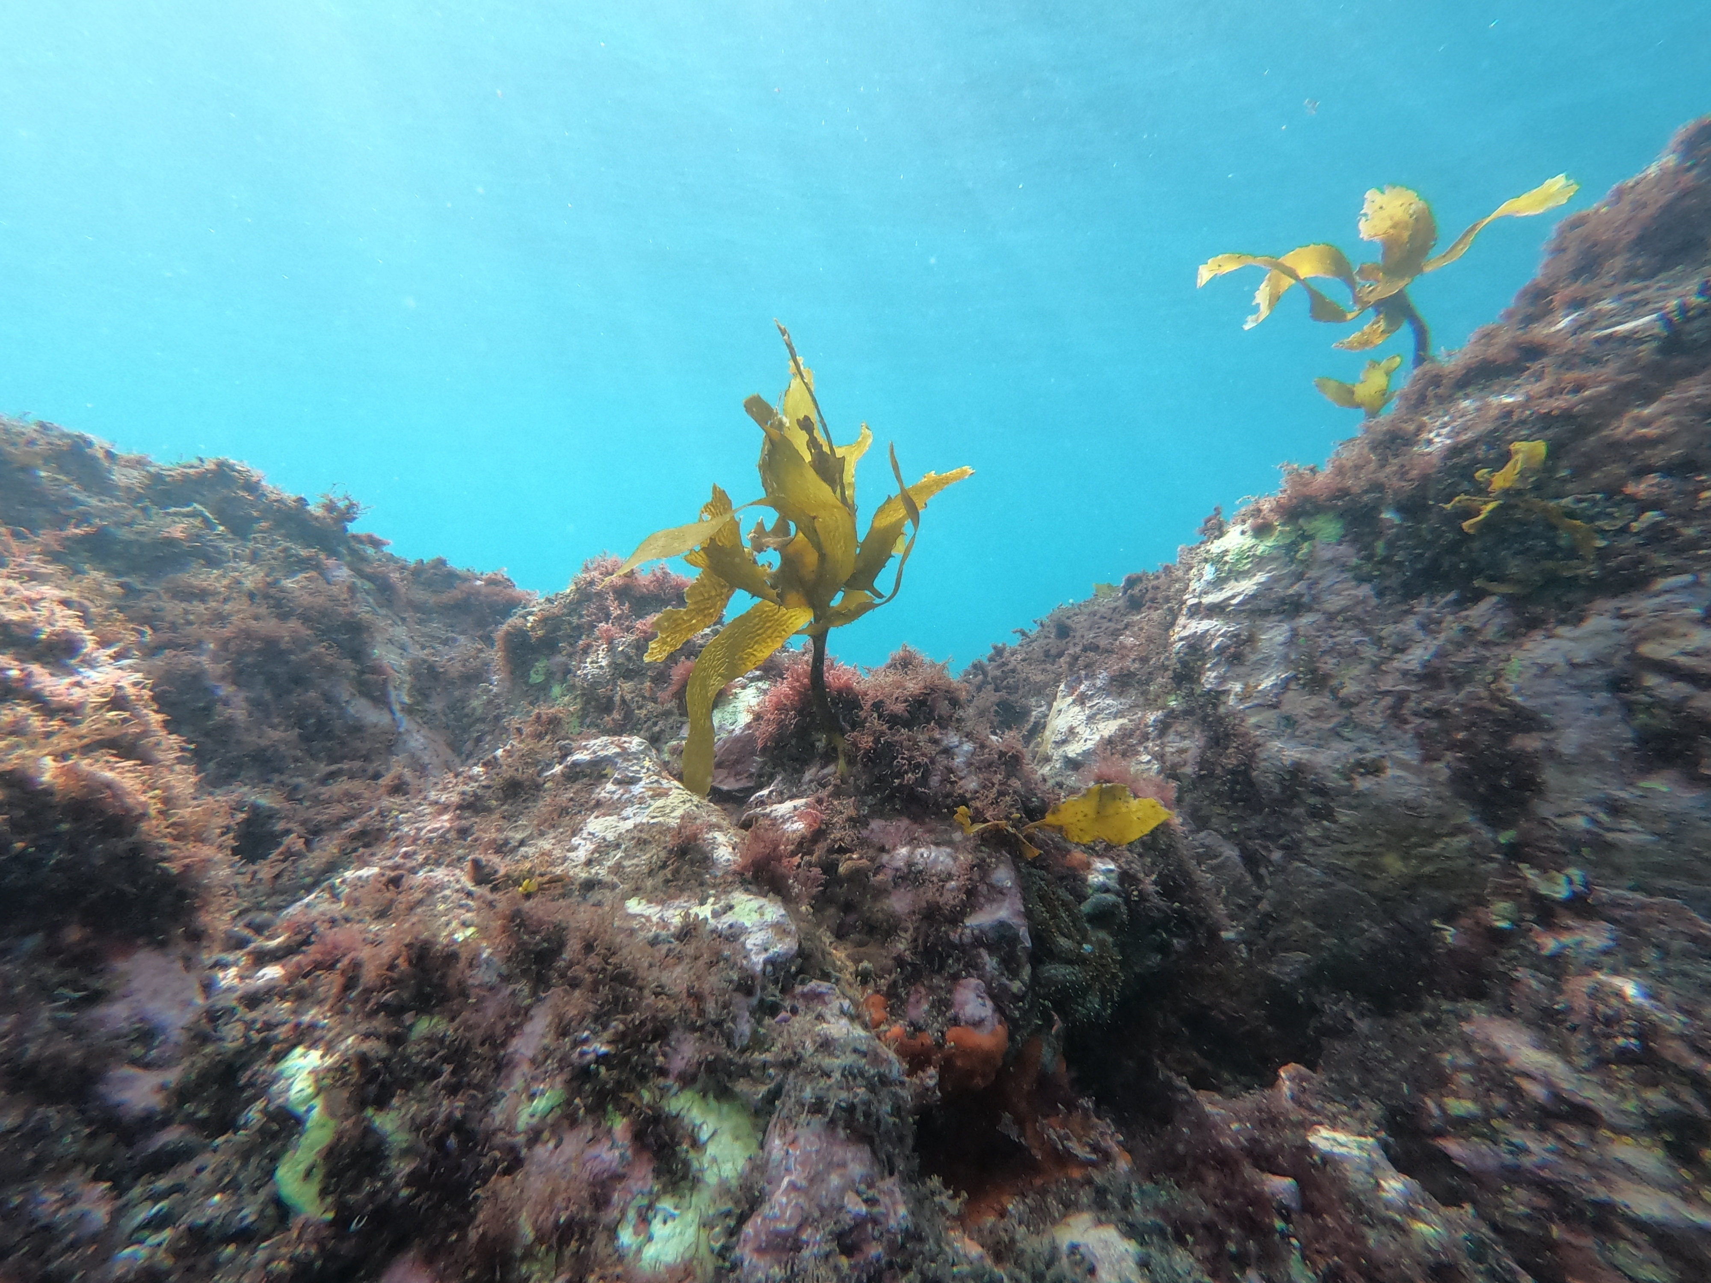
Acknowledgements
Shinichi and Losia
Leigh Marine Laboratory
Notes:
Thanks to Shinichi and Losia for their patience and their support with both research and coding, and thanks to Leigh Marine Lab for providing a productive study space.

